Slide 1

Nokwanda Maseko
19 March 2025
Localisation for industrialisation: implementation options and risks
TIPS Development Dialogue

Slide 2
Problem statement and aim of the paper
Benefits of localisation for reindustrialisation have not been fully realised, partly due to:
  Disagreement on the logic of localisation, and therefore fragmented implementation.
  Fragmentation hindering consolidation of state demand to support localisation.
  Influx of cheaper imports threatening local industries
Aims to provide analysis of localisation and procurement in South Africa.
Does so by reviewing:
  Import intensity of major industries.
  Existing policies and resources to support localisation.
  Summarising some views on localisation.
  Proposing short-term actions to support and strengthen existing interventions.

Slide 3
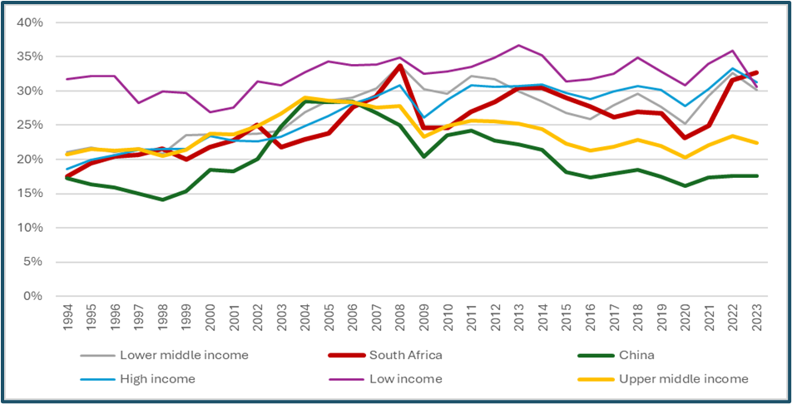
Import intensity and opportunities for localisation (1/2)
Not an outlier among peer economies.
Growth in imports share of GDP between 1994 and 2023.
  Peer economies stable at about a fifth after peaking at almost a third in early 2000s
Overall growth in value of SA imports in this period.
  In part due to inability to compete with cheaper imports.
  In part due to limited production capacity.
  Re-enforced by continued higher dependence on mining exports compared to peer economies.
Graph 1: South Africa’s imports of goods and services as a share of GDP compared to China and other upper-middle-income economies and income groups
Source: From Makgetla (2023:4). Note: Updated to 2023 using data from World Bank. World Development indicators. Interactive dataset. Downloaded from www.worldbank.org in August 2024.

Slide 4
Import intensity and opportunities for localisation (2/2)
Table 1: Imported product as a share of total annual imports, 2024
HS CODE | PRODUCT LABEL | SHARE OF TOTAL IMPORTS, 2024
27101230 | Diesel | 7%
27090000 | Crude oil | 5%
98010030 | Automotive components: for motor cars | 4%
98010040 | Original equipment components: for goods vehicles | 3%
27101202 | Light oils and preparations: Petrol | 3%
85171310 | Smartphones for wireless networks | 2%
87032290 | Cars and related vehicles: cylinder capacity 1 000 cm3 to 1 500 cm3 | 1%
30049099 | Medicaments consisting of mixed or unmixed products for therapeutic or prophylactic purposes | 1%
98010045 | Original equipment components: for goods vehicles | 1%
84713090 | Data-processing machines, automatic, portable, weighing <= 10 kg | 1%
SA imports dominated by petroleum and autos
Almost a third of total imports accounted for by the top 10 products
The top 100 products accounted for just over half of the value
  Petroleum imports more than a third of the value
  Autos & related parts at about a fifth
More than half of the top 100 is intermediate goods, and almost half is final goods
Also, notable growth in imports of renewable energy products, including solar panels.
Assessment of imports can point to areas of opportunity
  Identify opportunities based on value or volumes?
  Requires assessment of where there is existing capacity, or where capacity can be rapidly built-up.
  Possibility of linking identified products with those needed across infrastructure projects.
    Around R1 trillion in state infrastructure spending over the MTEF
    Across different services (e.g. education, human settlements)
Autos can provide some lessons
  Almost half of auto imports in top 100 are final products
  Worth further assessment given scope of support since the establishment of the local industry.
Source: Calculated based on SARS data from ITC Trade Map online interactive trade database. Downloaded from https://www.trademap.org in March 2025.

Slide 5
Localisation policy and resourcing (1/2)
Public:
  Designation key part of localisation efforts, especially since the early 2010s.
  Almost 30 products designated since then
  Designation mainly for firms looking to do business with the state.
  2017 public procurement regulations declared unconstitutional.
  Public Procurement Act of 2024 provides legal framework for designation.
  Only in certain instances.
    i.e. “…where only locally produced or manufactured goods meet the stipulated minimum threshold for local production and content, taking into account economic and other relevant factors…”
    Provisions not active yet – requires regulations
Public:
  Other public measures include tariffs and incentives.
  Incentives include grants, loans, tax credits and technical expertise etc.
  Tariffs also used to protect local industry.
    Can be import tariffs to protect against influx of cheaper imports
    Also export tariffs to ensure security of supply of inputs.
  Competition Commission also increasingly using public interest conditions to protect and increase local production.
Private:
  Private efforts largely centred around Proudly South Africa
  Not founded in law, but rather depends on individual producers and consumers
  Proudly South African – membership organisation has been at the forefront of these efforts.
Masterplans also increasingly playing an important role, with local content commitments from different industries.

Slide 6
Localisation policy and resourcing (2/2)
PROGRAMME | KEY OBJECTIVES | KEY REQUIREMENTS | SUPPORT
Black Business Supplier Development Programme (DSBD) | Fast-tracking SMME’s with potential for growth Growing Black-owned SMMEs through linkages to corporate and public sector enterprises | 51% Black majority shareholding R250 000 to R35 million turnover per year Operational for one year at minimum Registered for VAT | Up to R1 million R800 000 50:50 cost-sharing for machinery, equipment and tools R200 000 80:20 cost-sharing for business development and training
Strategic Partnership Programme (dtic) | Encouraging large private sector enterprises and state collaboration to support, nurture and develop SMEs within the partner’s supply chain | Legally registered in South Africa per the Companies Act Minimum turnover of R100 million per annum over two consecutive financial years at least In compliance with BBBEE with valid compliance certificate | Cost-sharing between government and strategic partners to provide infrastructure and business development Up to R15 million per financial year over three years (subject to availability of funds)
Downstream steel industry competitiveness fund (IDC) | To help the steel industry with an interest subsidy with discounts for qualifying clients. | Start-up or established business. Be either: Achieve BBBEE Level 4 or submit plan to achieve Level 4 within 36 months, or Be at least 50% Black-owned (regardless of BBBEE score), or Where funding will increase capacity or employment creation (without monopolising the value chain). | Interest subsidy up to R75 million for SMEs and large businesses with differing pricing models. Guarantees and subsidy on guarantee fees: Up to R10 million per client for 5 years, 1% subsidy on guarantee fees up to R1 million per client for five years End-user finance interest rate subsidy: R1 million – R75 million at 2.5% fixed interest for 5 years.
Zimele enterprise, supplier and youth development programme (Anglo American) | Helping businesses within and outside the mining value chain to grow, diversify, innovate and respond to buyers’ procurement needs. | Majority (>51%) Black owned. Within a mining community or zone of influence supplier. With existing systems for ethics and good governance. Able to match business supply chain opportunities. | Business and financial topics training. Assistance with developing a growth plan. Link to market opportunities. Access to supplier roundtables and other workshops.

Slide 7
Proposed policy options and short-term interventions to foster increased local production and consumption (1/3)
POLICY AREA | INTERVENTION | SHORT-TERM ACTIONS | BENEFICIARIES | RISKS AND COSTS
Public procurement | Designation for organs of state | Review designation process and ensure compliance with the legal requirements. Create a clear framework for designating products aligned with state procurement. | Local manufacturers. | Higher procurement costs for the state as industries develop. New framework not communicated to organs of state and officials not capacitated to ensure compliance.
 | Procurement | Redesigning tenders to disallow specification of brand names by procurers. Tenders redesigned to align with local production as far as possible. | Local manufacturers. | Delayed process for standardising tenders to remove specification of brand names and specifications not required for local needs.
 | Set asides | Improve monitoring systems to ensure compliance with specified set asides for targeted groups (e.g. 30% of tender procured from SMMEs). Improve systems to identify where large firms can collaborate with SMMEs. | Formal and established manufacturers (possible improvement in access to inputs from local value chains). SMMEs (integration into local value chains, including access to large state demand). | Integration might keep SMMEs entrenched in certain segments of the value chain without ability to move up. SMMEs not properly resourced to take advantage of set-asides, leading to imports.

Slide 8
Proposed policy options and short-term interventions to foster increased local production and consumption (2/3)
POLICY AREA | INTERVENTION | SHORT-TERM ACTIONS | BENEFICIARIES | RISKS AND COSTS
Private procurement | Assessment of local production capacity | Use available data to assess local production capacity across sectors. | Local manufacturers | Available data might not account for informal or small businesses. Some businesses might consider such information to be confidential.
 | Improving public messaging on local production and consumption (through Proudly SA for instance). | Use Proudly SA and industry bodies’ membership base and forums to promote production and procurement of local goods. Facilitate visibility of locally produced goods for procurement by households. | Local manufacturers including small businesses. | Consumers unwilling to increase consumption of locally produced goods. Creating winners (likely large businesses) and losers (likely SMMEs) through unequal visibility opportunities.
 | Develop supply chains to support local production | Industry-level assessment of availability of inputs that disrupt production (e.g. textiles for the clothing industry). Identify areas of collaboration across the region where suppliers can provide inputs. Identify existing value chains where participants can be supported and integrated into existing local value chains (e.g. legal metal recyclers that can support foundries and other metal fabricators. | Local manufacturers. SMMEs. Regional suppliers. | Lack of capacity to conduct the necessary assessments. Producers apprehensive about collaboration. Difficulty in building and integrating local and regional supply chains.

Slide 9
Proposed policy options and short-term interventions to foster increased local production and consumption (3/3)
POLICY AREA | INTERVENTION | SHORT-TERM ACTIONS | BENEFICIARIES | RISKS AND COSTS
Cross-cutting capacity building measures (public and private) | Capacity-building to support local production. | Assess some existing programmes to ensure alignment with current needs. State consolidation of some existing (and similar) support measures (financial and non-financial) to enable better support of businesses (especially SMMEs). Improve collaboration with business to facilitate capacity building between large and SMMEs. | Local producers | Lack of capacity for conducting assessments. Apprehension from stakeholders on building collaboration networks. Potential delays in providing support owing to assessment process.
 | Improving institutions and systems to foster industry competitiveness | Collaboration between public & private sectors and standards bodies (SABS, NRCS) to identify existing challenges and areas of improvement for compliance with standards and specifications. Develop a framework for identifying new standards and specifications to be integrated into the local system. | Local producers. Consumers. | Increased costs for businesses. Delay in setting of standards. Protracted processes for setting standards. New standards too specific to South Africa, therefore hindering export potential.
 | Demand-side support measures to foster production and consumption | Develop a framework for consumer incentives. Develop a framework for identifying goods where consumer incentives can be used to support local production (e.g. consumer incentive for solar installation can be used to increase local production of the relevant technologies). | Local producers. Local consumers | Lack of financial resources for consumer incentives. Structural inequality entrenching access to incentives among a certain class.

Slide 10
Thank You

